Slide 1
A 180-Day Habit Tracker Analysis:
Finding My Drivers of Well-being📊
The project highlights how even small, seemingly behaviors (like meditation or sugar consumption) can have measurable psychological effects.
In this project, I have applied exploratory data analysis, trend tracking, and correlation modeling to a 180-day personal habit tracker to uncover the behavioral patterns that most influence well-being.
The goal was to identify habitual drivers of mood, measure consistency trends, and build data-backed self-awareness using Python (pandas, seaborn, matplotlib) — replicating how a business might analyze consumer behavior, only here, the consumer is myself.

Slide 2
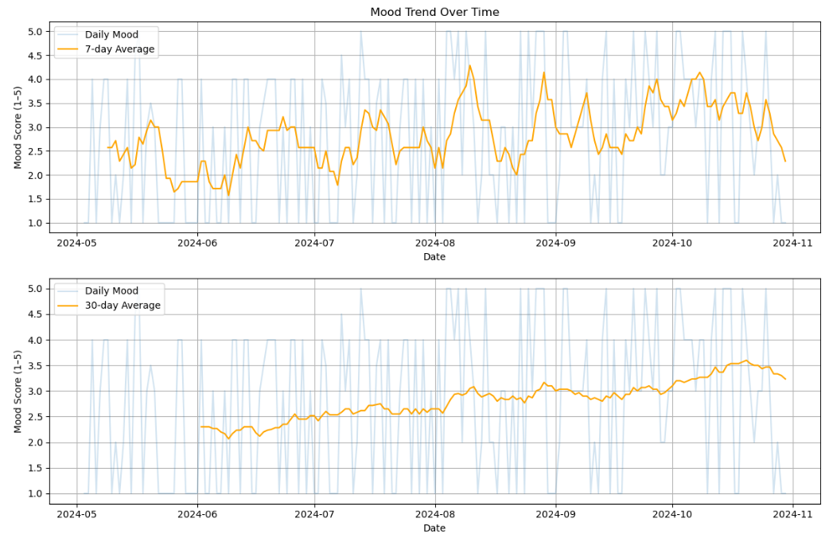
Tracking overall mood health and streak analysis
The 30-day average shows a sustained upward trajectory starting late July, which continues through September and early October.
What went well and what could be better?
  June: despite high workout and meditation frequency, mood declined. This could be because sugar consumption may have offset the benefits (second lowest frequency of sugar control)
  In July - August: although workout streak dipped, frequency was fairly stable. Plus, meditation and no sugar streak slightly increased in August.
  High consistency in workout and meditation in June (high correlation with mood scores) possibly showed a ripple effect in the high mood health in July – August.
Habit frequency and streaks relatively weakened in October, which could also be the reason of mood scores dipping in late October.
Mood was lowest in June
Sharply improved in early Aug
overall improvement
Monthly Habit - Longest Streak:
{'2024-05': {'Workout': 6, 'Meditated': 3, 'Journaled': 3, 'No Sugar': 2},
'2024-06': {'Workout': 8, 'Meditated': 5, 'Journaled': 4, 'No Sugar': 2},
'2024-07': {'Workout': 3, 'Meditated': 4, 'Journaled': 4, 'No Sugar': 3},
'2024-08': {'Workout': 4, 'Meditated': 6, 'Journaled': 4, 'No Sugar': 5},
'2024-09': {'Workout': 3, 'Meditated': 3, 'Journaled': 5, 'No Sugar': 3},
'2024-10': {'Workout': 2, 'Meditated': 3, 'Journaled': 3, 'No Sugar': 3}}
Monthly Habit - Frequency:
{'2024-05': {'Workout': 14, 'Meditated': 12, 'Journaled': 7, 'No Sugar': 12}, '2024-06': {'Workout': 20, 'Meditated': 17, 'Journaled': 15, 'No Sugar': 10},
'2024-07': {'Workout': 19, 'Meditated': 18, 'Journaled': 18, 'No Sugar': 8},
'2024-08': {'Workout': 17, 'Meditated': 15, 'Journaled': 14, 'No Sugar': 17},
'2024-09': {'Workout': 14, 'Meditated': 16, 'Journaled': 16, 'No Sugar': 16},
'2024-10': {'Workout': 11, 'Meditated': 14, 'Journaled': 10, 'No Sugar': 13}}

Slide 3
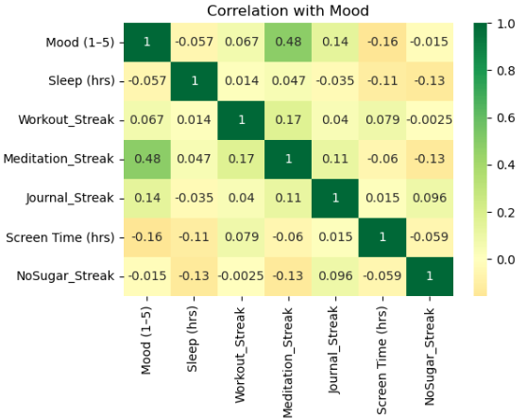
Understanding the Key Drivers of Emotional Health - Mindfulness habits show the strongest link to mood, while other behaviors act as supporting factors
Among all tracked habits, meditation has the strongest positive relationship with mood (0.48) followed by journalling, suggesting a clear link between mindfulness and emotional well-being.
Workout has some positive correlation (0.067), but weaker than expected. Implies workouts may need to be supported by other habits (like mindfulness, sugar control) to impact mood.
Habits like sugar control don’t show strong linear relationships, contrary to the assumption based on behavioral trends. This might be suggesting that sugar alone doesn't dictate mood either, but likely acts as a supporting factor in the broader picture.
My learnings and takeaways from this project:
Consistency across multiple habits drives momentum – so smaller steps in multiple keystone habits is better than focusing on only one habit in isolation.
Considering that mood as an outcome may not always respond instantly, rolling averages provide a helpful directional insight.
This also indicates that analyzing correlation that incorporates some lag in the model could be more helpful.
Correlation doesn’t imply causation (for example: sugar-free days being weakly associated with low mood doesn’t imply that consuming sugar has no impact on mood at all).
….. and how it can be applied to a business context:
Over-indexing on one specific user behaviour to predict the outcome may not give useful insights. It’s very important to track quantifiable loyalty behaviors (repeat purchase, interaction with new campaigns) instead of just revenue brought in by a consumer.
A user may not show immediate satisfaction or loyalty after signing up or trying a product once. But repeated exposure or use can create stickiness.

Slide 4
Thank you!

